Slide 1
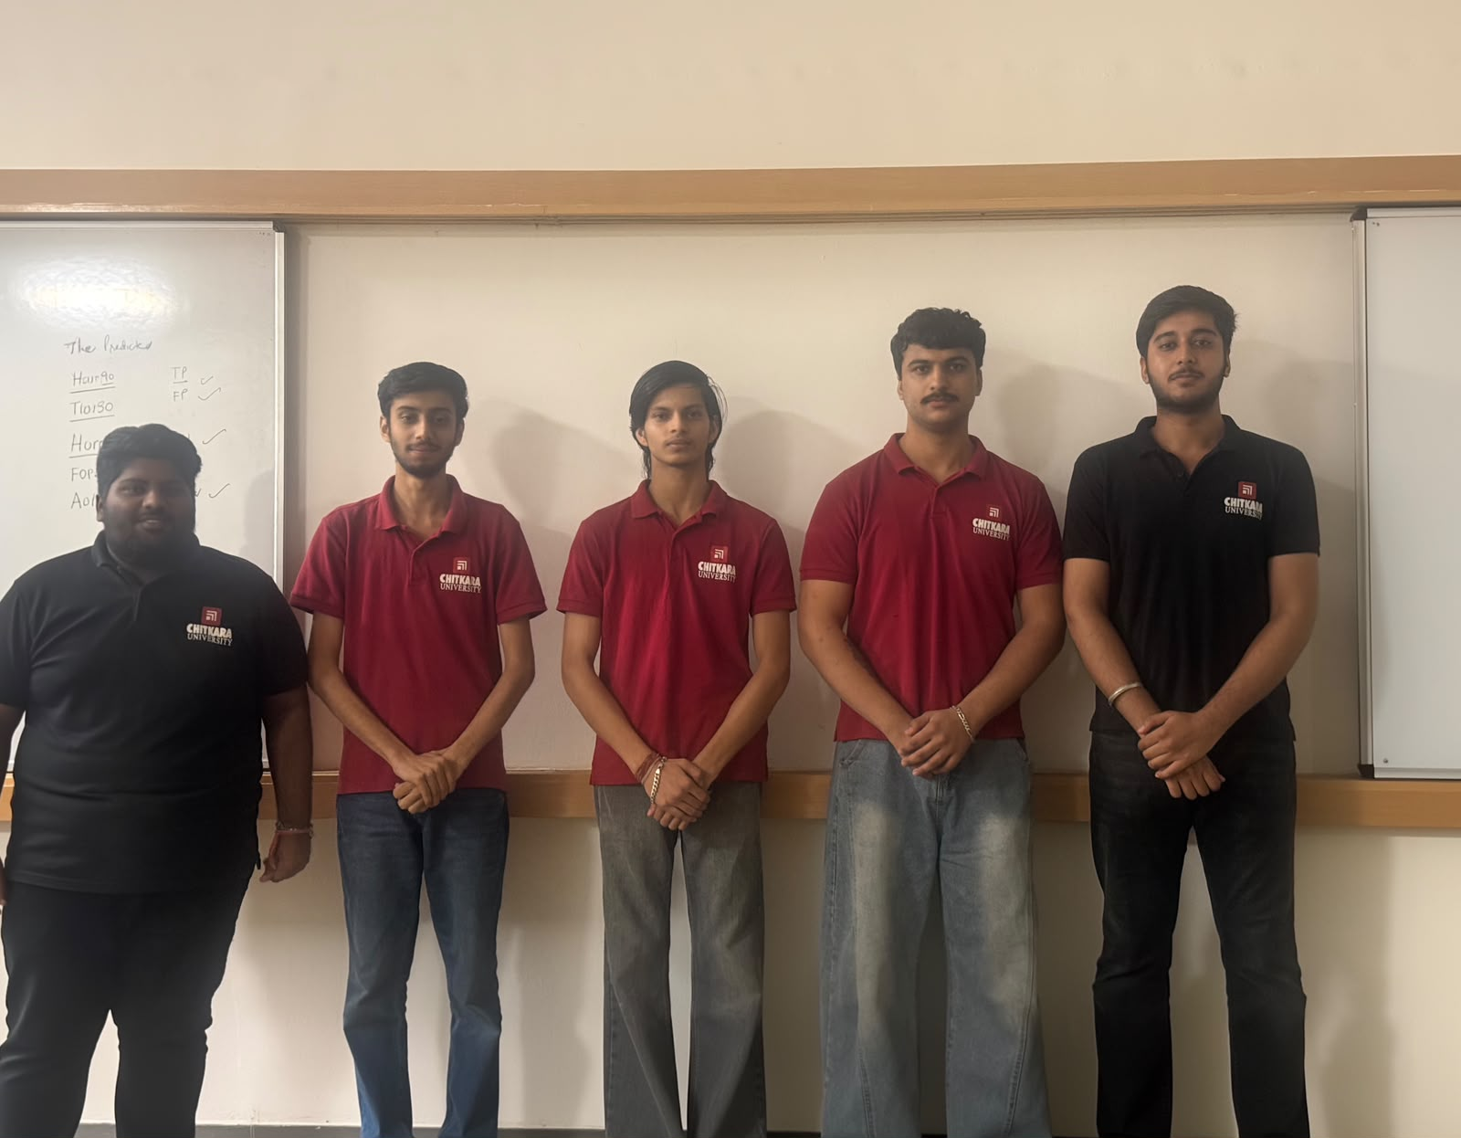
Chitkara University CBS BBA in FinTech and Artificial Intelligence
Group 3
Abhishek Shorey • Danish • Chirag Pathania
Akash Thakur • Harsh Kumar • Bhavya

Slide 2

AI/ML INTEGRATED CASE STUDY
Predicting Player Churn
& Personalizing Engagement
Krafton Inc. — turning player signals into timely, responsible action
Chitkara University CBS BBA in FinTech and Artificial Intelligence | Group 3
Abhishek Shorey • Danish • Chirag Pathania
Akash Thakur • Harsh Kumar • Bhavya

Slide 3

01
Krafton Inc. — built for live service
A South Korean publisher operating multiplayer worlds at global scale.
100M+
monthly active mobile + PC gamers
PUBG: BATTLEGROUNDS • BGMI (India Only)
Recurring revenue comes from Royale Passes, cosmetics and virtual currencies such as UC / G-Coin.
KRAFTON • PLAYER RETENTION CASE STUDY
02

Slide 4
02
Player churn is a revenue warning
Churn = a player stops playing for a defined period. The danger is concentrated: the top 5–10% of players can generate ~80% of income.
60–70%
of new free-to-play players may leave within 14 days
4–6×
more expensive to acquire a new player than retain one
Mid-tier payers often leave after frustration, content fatigue or unrewarding loops.
KRAFTON • PLAYER RETENTION CASE STUDY
03

Slide 5
03
Three data lenses tell one player story
01 TELEMETRY
02 ECONOMY
03 ENGAGEMENT + SOCIAL
Sessions • match completion • survival time • K/D • streaks
LTV • transaction frequency • currency balance • price sensitivity
Royale Pass progress • last active • friends • toxicity flags
Shows skill, friction and changing play habits.
Reveals value, affordability and purchase intent.
Signals belonging, momentum and experience quality.
KRAFTON • PLAYER RETENTION CASE STUDY
04

Slide 6
04
Predict first. Personalize second.
RANDOM FOREST
7-DAY CHURN RISK
PLAYER SIGNALS
PERSONALIZED OFFER
~80% accuracy identifying high-risk players
LightFM / matrix factorization ranks the most relevant store or quest offer.
Example: high risk + low sessions → beginner quest reward, not an aggressive discount.
KRAFTON • PLAYER RETENTION CASE STUDY
05

Slide 7
05
Retention becomes a daily business process
COLLECT
Gameplay + store events
SCORE
Risk from 0.00–1.00
FLAG
High risk if > 0.75
ACT
Quest, XP or discount
Right action • right player • right moment
Automation scales retention; managers still define thresholds, budgets and ethical guardrails.
KRAFTON • PLAYER RETENTION CASE STUDY
06

Slide 8
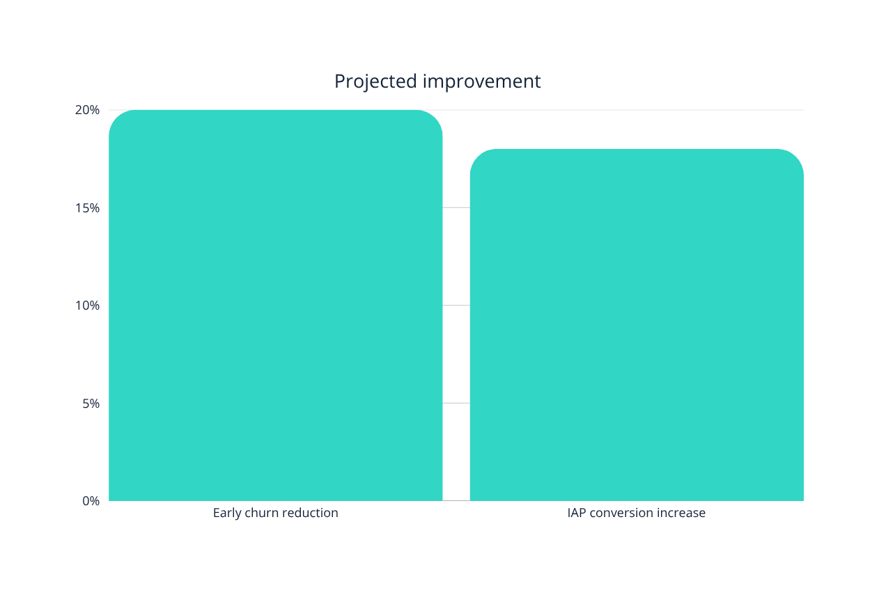
06
Projected impact — not guaranteed outcomes
20%
less early churn through proactive retention quests
18%
higher IAP conversion through personalized storefronts
KRAFTON • PLAYER RETENTION CASE STUDY
07

Slide 9

07
Responsible Model protects players and trust
PRIVACY • All the Government Privacy Regulations require special care with minors and device data.
FAIRNESS • Never manipulate matchmaking to pressure spending.
MONETIZATION • Avoid aggressive loot-box targeting of vulnerable players.
MODEL DRIFT • Updates change behavior; accuracy must be monitored.
KRAFTON • PLAYER RETENTION CASE STUDY
08

Slide 10
08
AI tools helped translate — not replace — judgment
ChatGPT + Gemini
Perplexity AI
Core research prompt
Structured the case and translated model logic into business language.
Supported fact-checking on gaming churn and monetization.
Asked for live-service churn prediction, industry examples, reliable sources and ethical risks.
Better prompts add role + context + constraints + evidence + ethics.
KRAFTON • PLAYER RETENTION CASE STUDY
09

Slide 11
09
Prompt refinement changed the quality of insight
BEFORE
AFTER
“How can AI reduce player churn?”
“Act as a gaming data scientist. Compare XGBoost and recommendation systems; cite reliable sources; address minors, fairness and drift.”
Generic • broad • unverified
Weak link to management action
Focused • actionable • source-aware
Ethically cautious for decisions
KRAFTON • PLAYER RETENTION CASE STUDY
10

Slide 12
10
Four management decisions make Model useful
EXPLAIN
PROTECT
Understand why AI has selected a player
Set spending limits, especially for minors
RETRAIN
CONNECT
Update the AI model when player behavior changes
Use AI for business growth ,but in a responsible way
KRAFTON • PLAYER RETENTION CASE STUDY
11

Slide 13
11
What the team learned — and built
AI predictions should be converted into useful actions
AI should be used responsibly, not only for money making
3 Good and clear prompts give better research results
KRAFTON • PLAYER RETENTION CASE STUDY
12

Slide 14
11
Thank You
Team Members
Abhishek Shorey (2520992510)
Danish (2520992578)
Chirag Pathania (2520992571)
Akash Thakur(2520992519)
Harsh Kumar (2520992612)
Bhavya (2520992563)
KRAFTON • PLAYER RETENTION CASE STUDY
12

